Slide 1

Communication protocol integration on FPGA
UART, SPI, I2C
KIRTAN A. MAKWANA – 92200133031
Capstone Project (01CT0715)

Slide 2
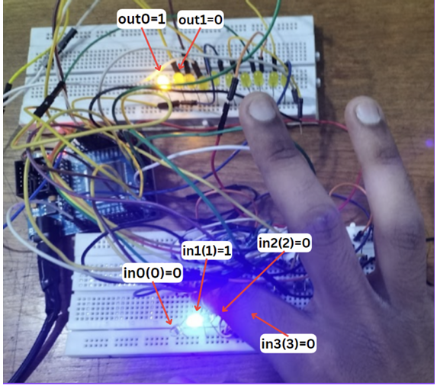
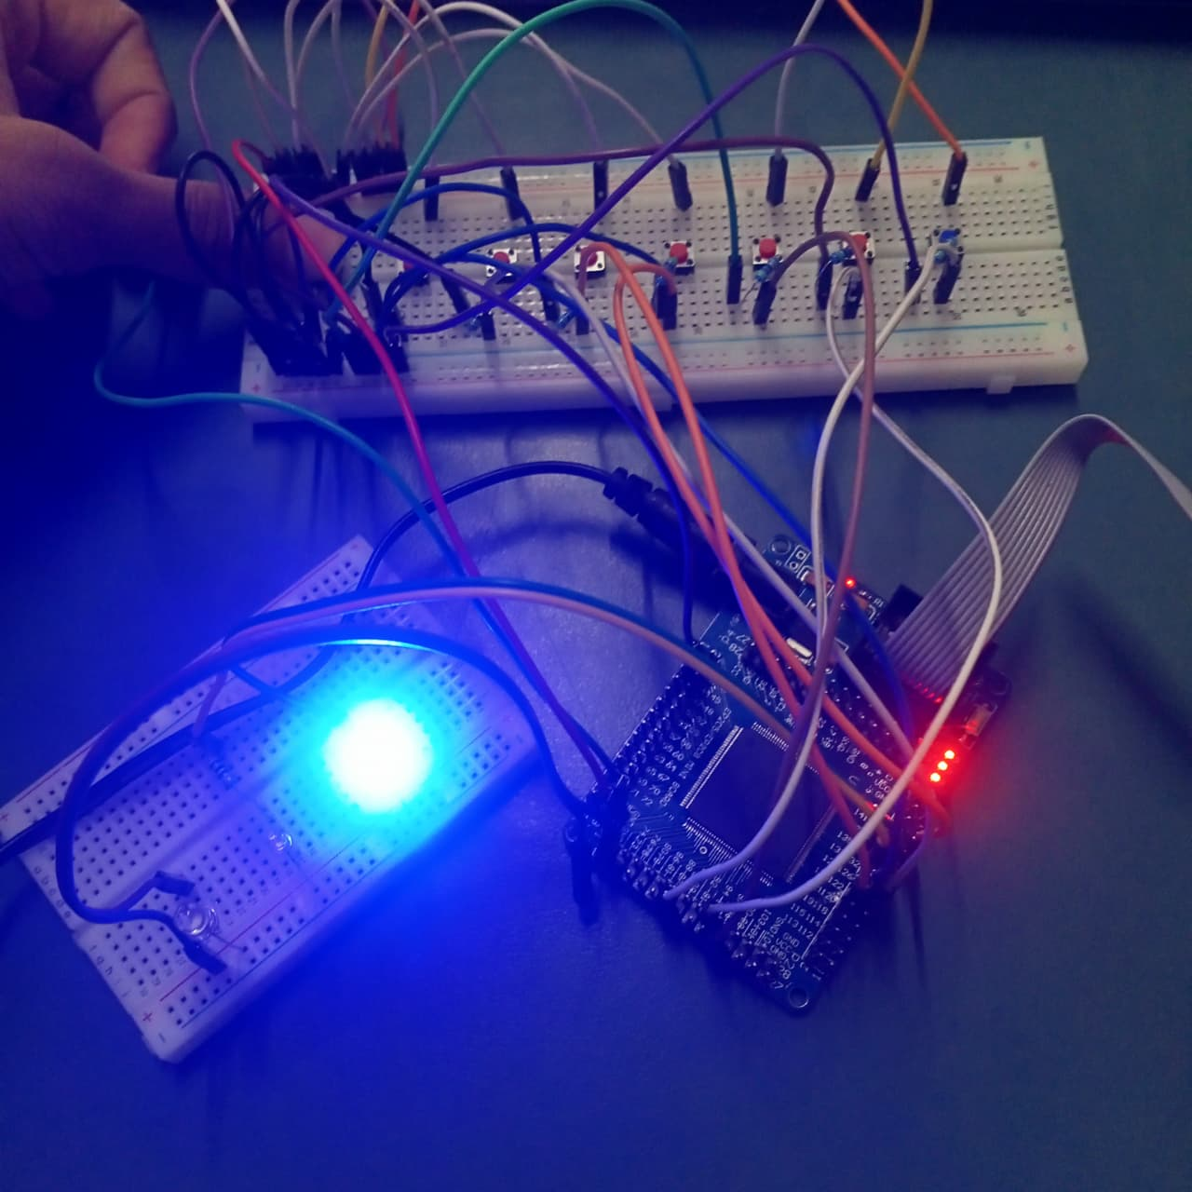
Problem Statement
Configuring the Altera Cyclone II FPGA board with only LED to monitor the Output takes too many wires, so interfacing it might create some confusion.
We can add serial input to the FPGA via serial communication and we can also implement a serial communication protocol to see output on any Displays.

Slide 3
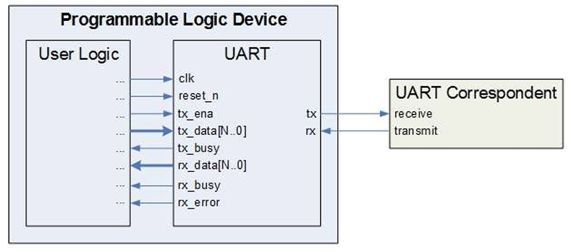
UART
What is UART?
UART stands for Universal Asynchronous Receiver/Transmitter.
It is a hardware protocol used for serial communication, meaning it sends data one bit at a time over a single wire.
Its primary function is to convert parallel data from a device (like a CPU or microcontroller) into a serial format for transmission and vice-versa.
Key Characteristics
Asynchronous: No shared clock signal is needed between the sender and receiver. They are synchronized for each byte using the Start and Stop bits.
Two Wires: Basic communication requires only two signals:
TX (Transmit): To send data.
RX (Receive): To receive data.

Slide 4
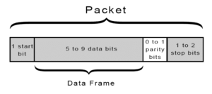
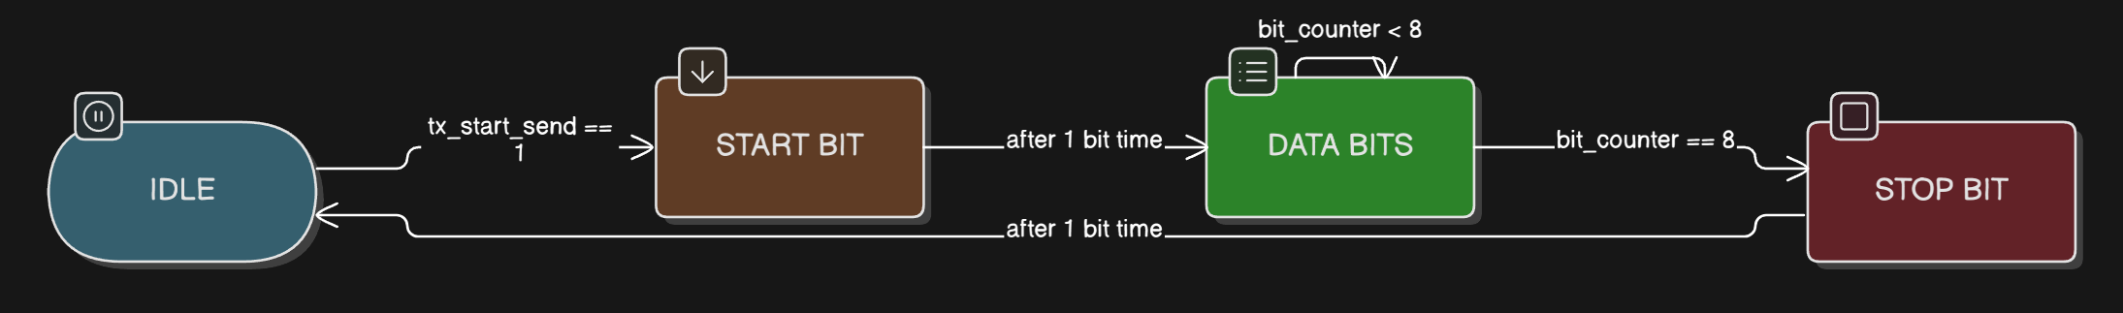
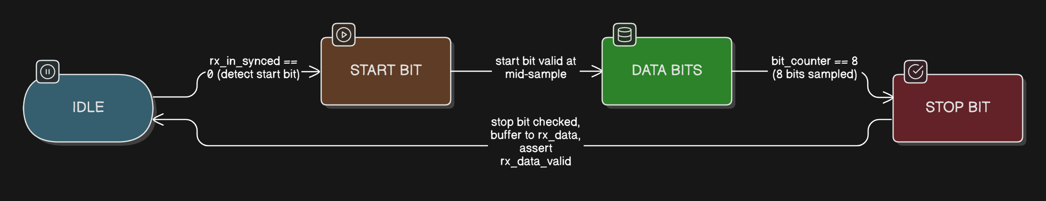
UART

Slide 5
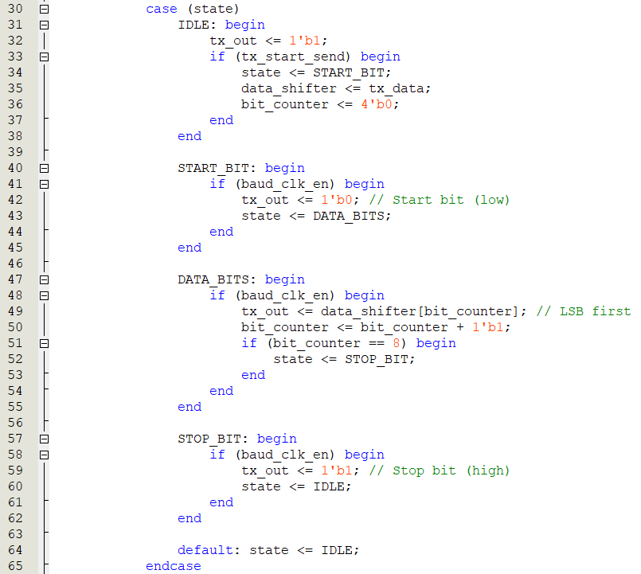
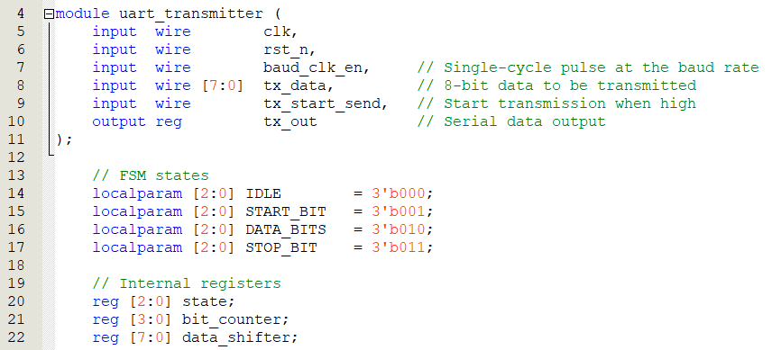
UART (Tx)

Slide 6
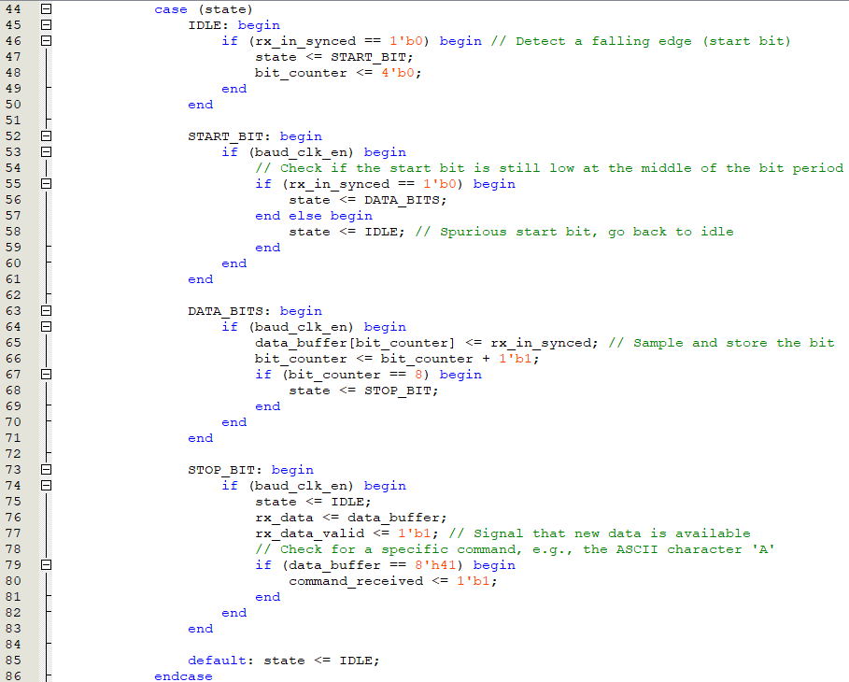
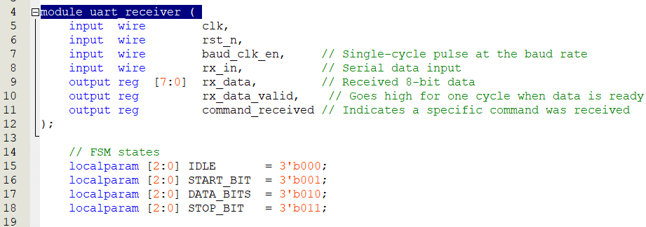
UART (Rx)

Slide 7
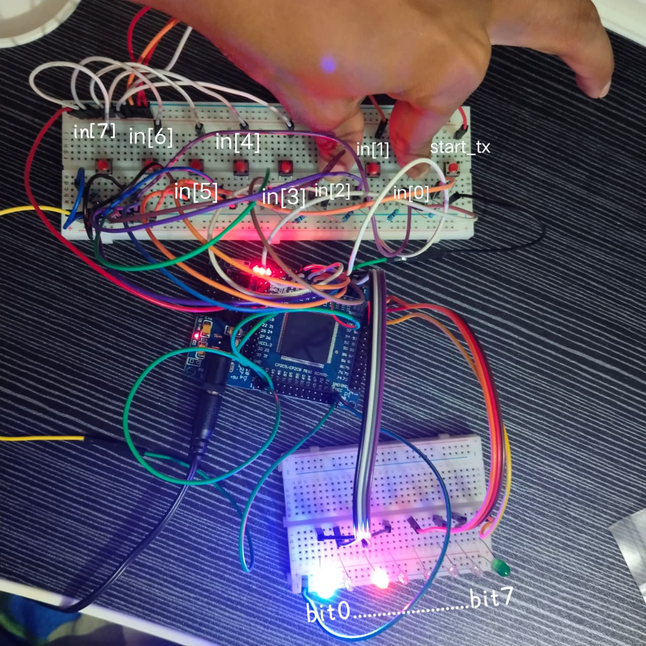
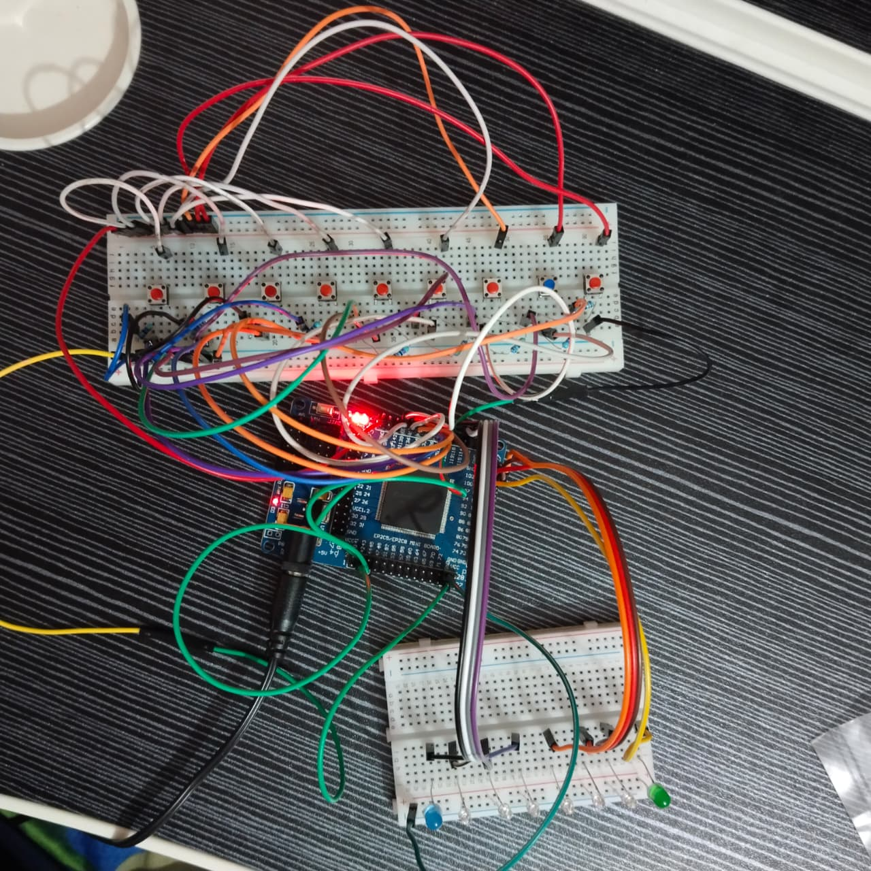
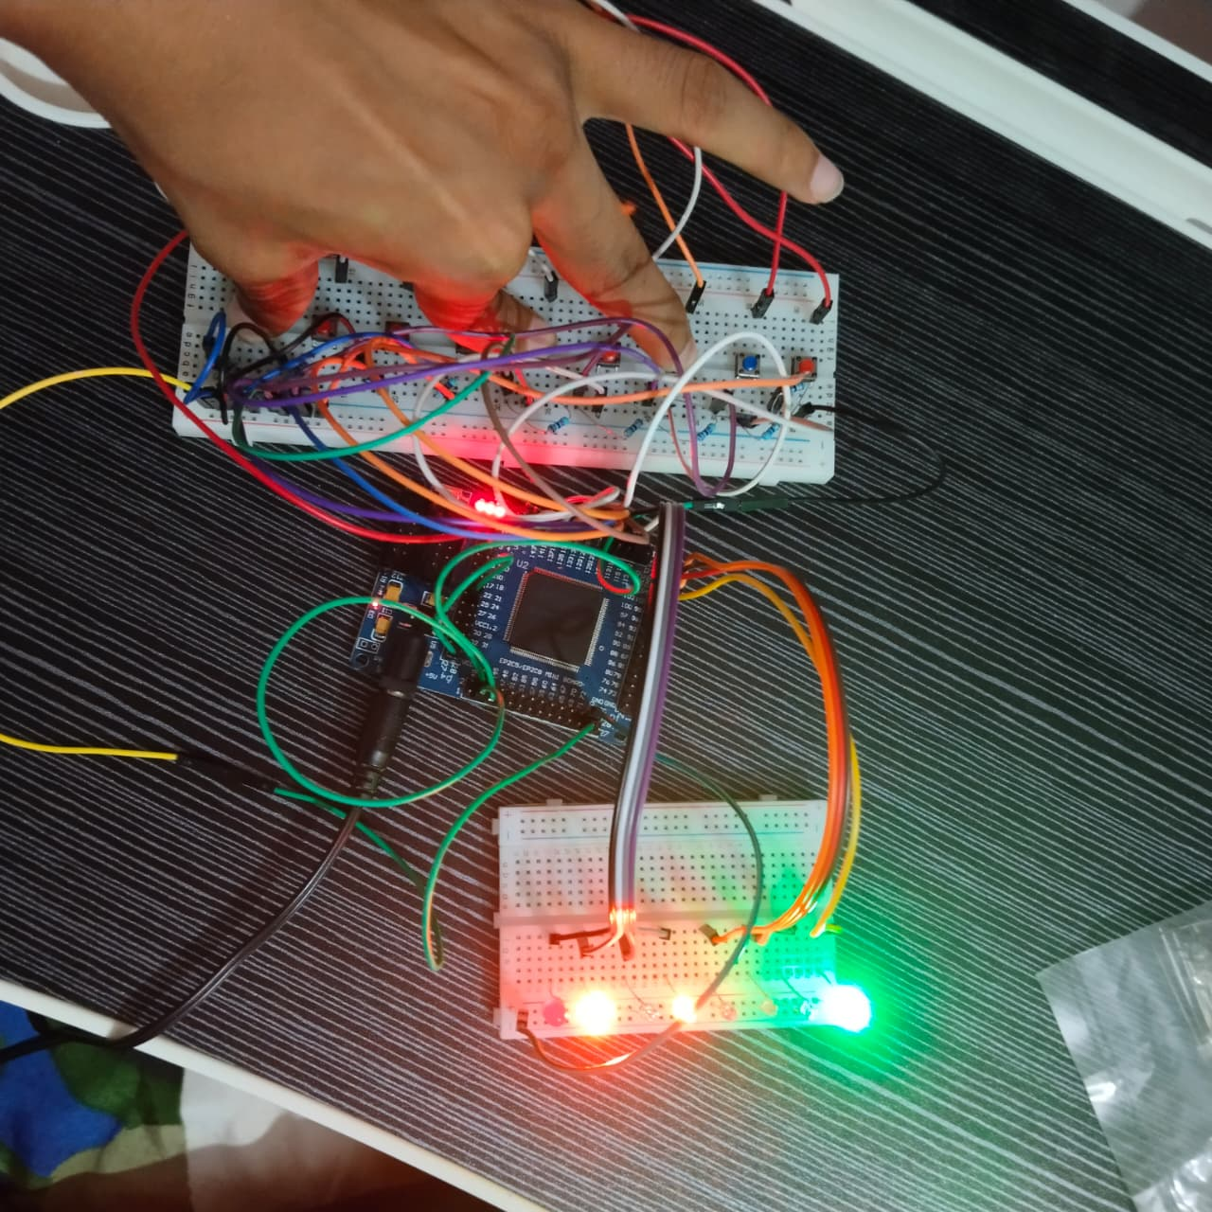
UART Implementation

Slide 8
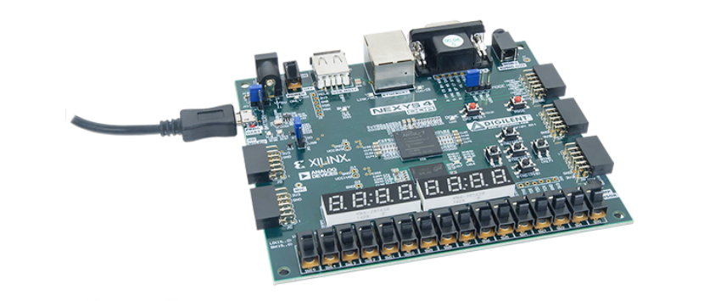
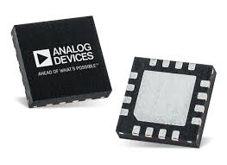
SPI communication
Module : ADXL362
aka Acc-Gyro Sensor

Slide 9
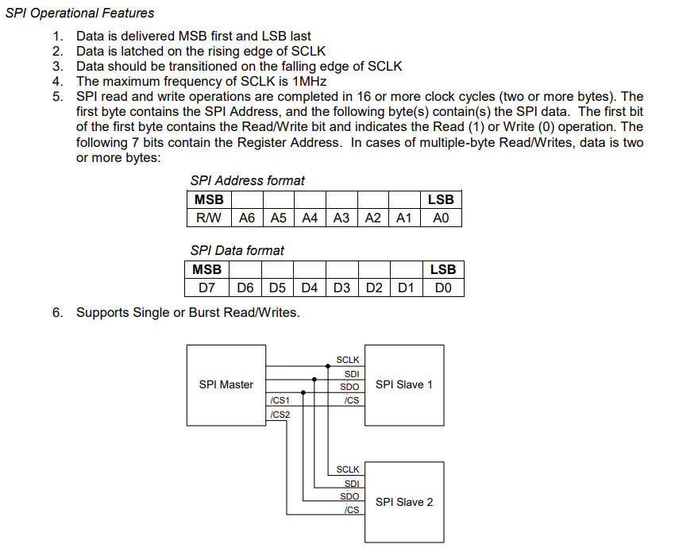
SPI communication

Slide 10
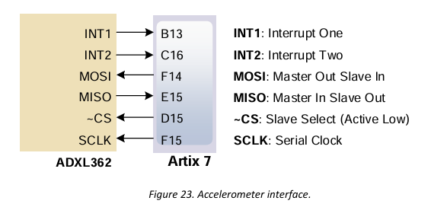
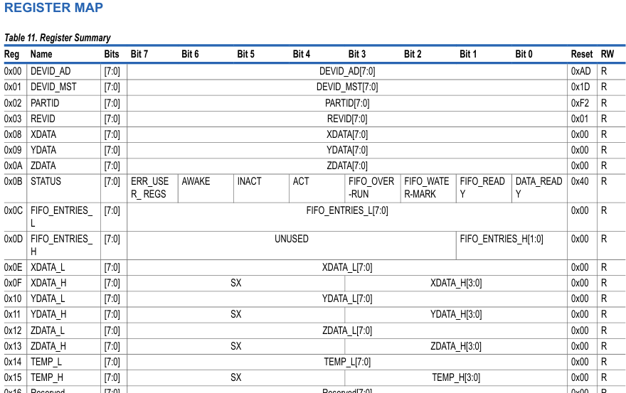
SPI communication

Slide 11
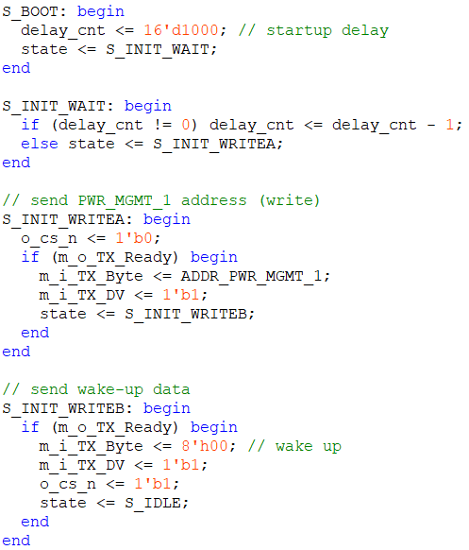
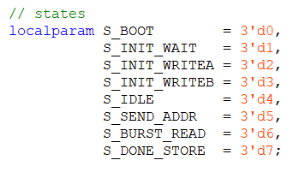
SPI communication
BOOT / INIT: Sensor wake-up and initialization.
IDLE: Waits for start signal to begin transaction.
SEND_ADDR: Sends sensor register address with read flag.
BURST_READ: Reads multiple bytes using dummy writes.
DONE_STORE: Stores received data, displays raw temperature on LEDs.
Result: FPGA communicates with sensor via SPI and retrieves temperature data.

Slide 12
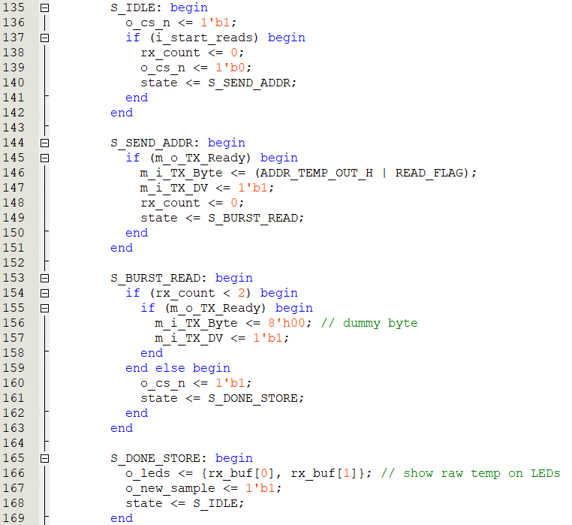
SPI communication
BOOT / INIT: Sensor wake-up and initialization.
IDLE: Waits for start signal to begin transaction.
SEND_ADDR: Sends sensor register address with read flag.
BURST_READ: Reads multiple bytes using dummy writes.
DONE_STORE: Stores received data, displays raw temperature on LEDs.
Result: FPGA communicates with sensor via SPI and retrieves temperature data.

Slide 13
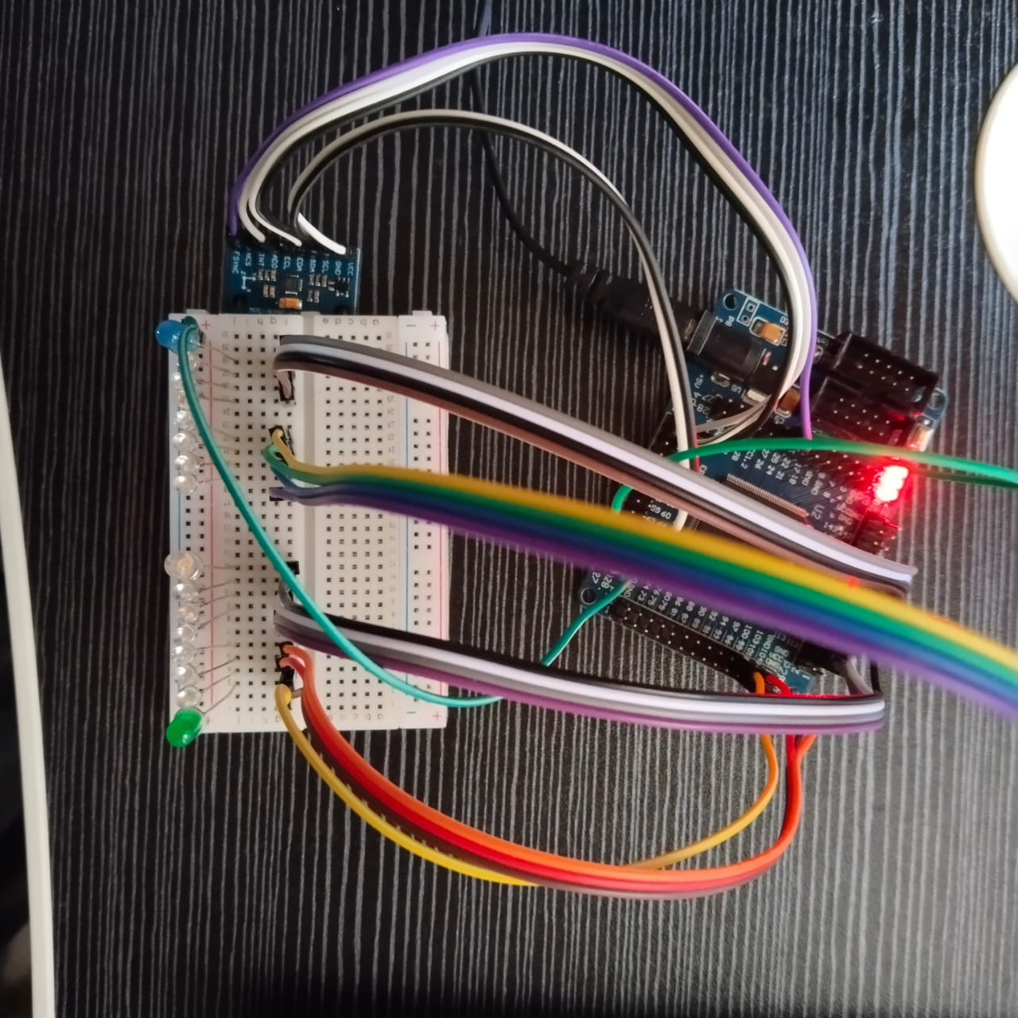
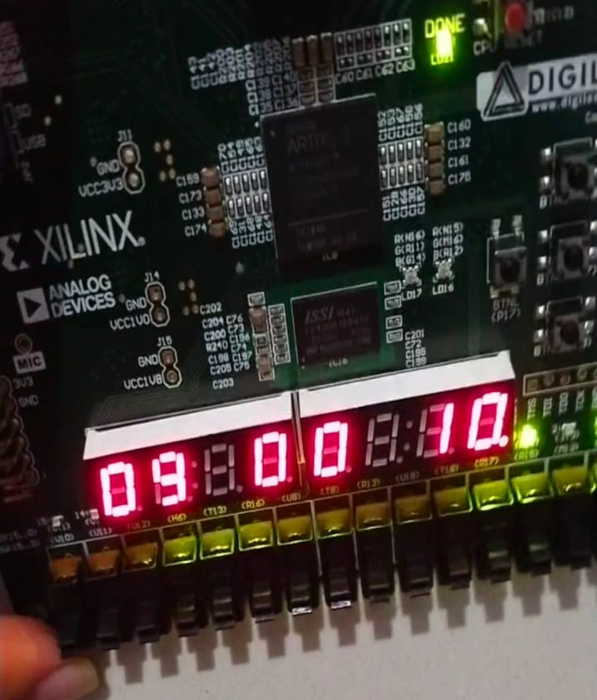
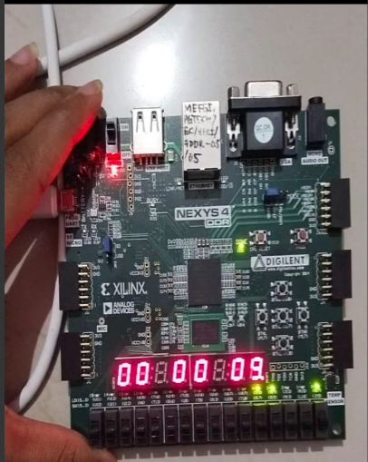
SPI communication

Slide 14
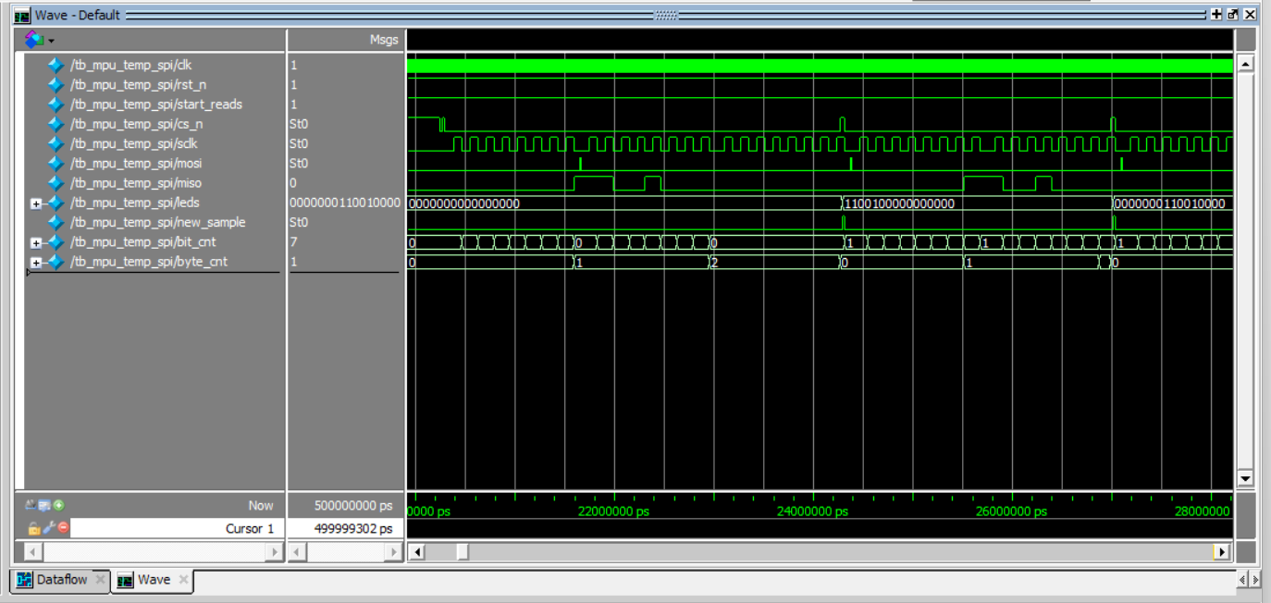
SPI waveform simulation

Slide 15
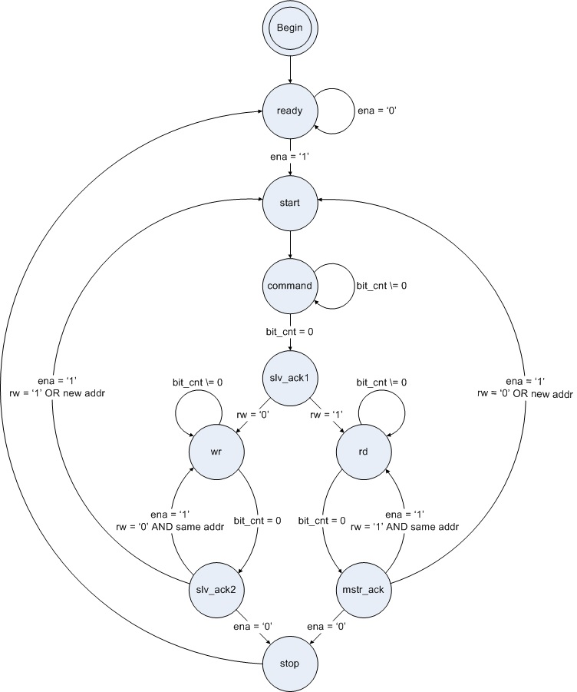
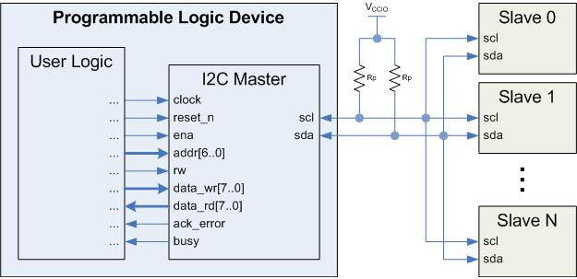
I2c communication
I²C Master Overview
I²C Bus: Two lines (SCL, SDA) shared by multiple slave devices.
Master Role: Generates clock, sends address, controls read/write.
Pull-up Resistors: Keep lines high when idle.
I²C FSM (State Machine)
Ready → Start → Command → ACK → Data Transfer → Stop
Handles read/write operations with proper synchronization and acknowledgments.

Slide 16
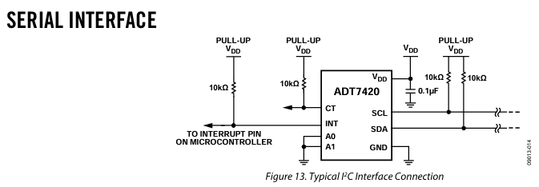
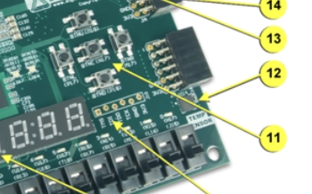
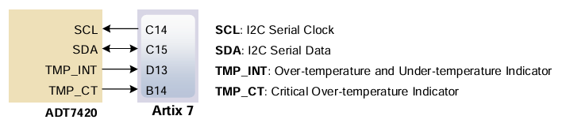
I2c communication

Slide 17
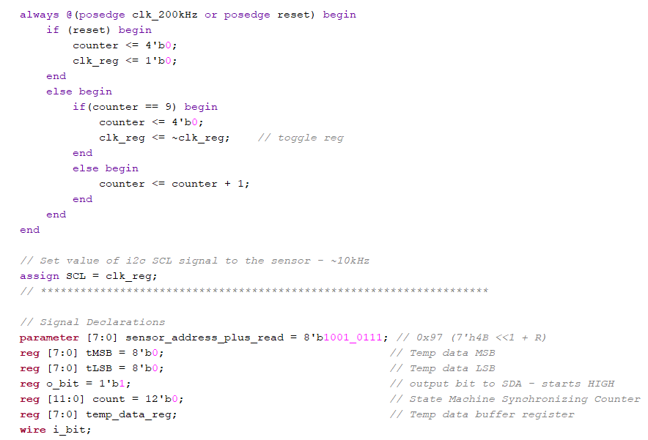
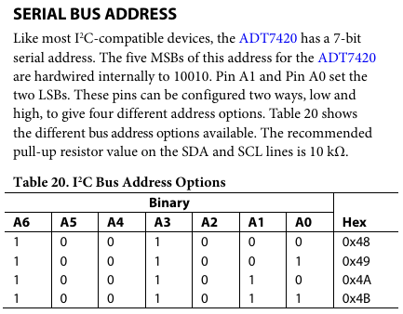
I2c communication
Implementation:
Verilog code to initialize display & send data
Data sent serially → converted to parallel by display

Slide 18
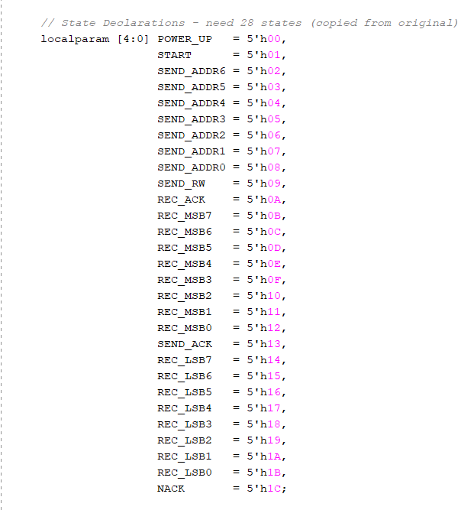
I2c communication
I²C Master State Machine:
IDLE: Waits for start signal, prepares data.
START: Generates I²C start condition.
TX BYTE: Sends 8-bit data serially (MSB → LSB).
WAIT ACK: Reads ACK/NACK from slave.
STOP: Generates stop condition, returns to IDLE.
Result: Complete I²C transaction from FPGA to OLED.

Slide 19
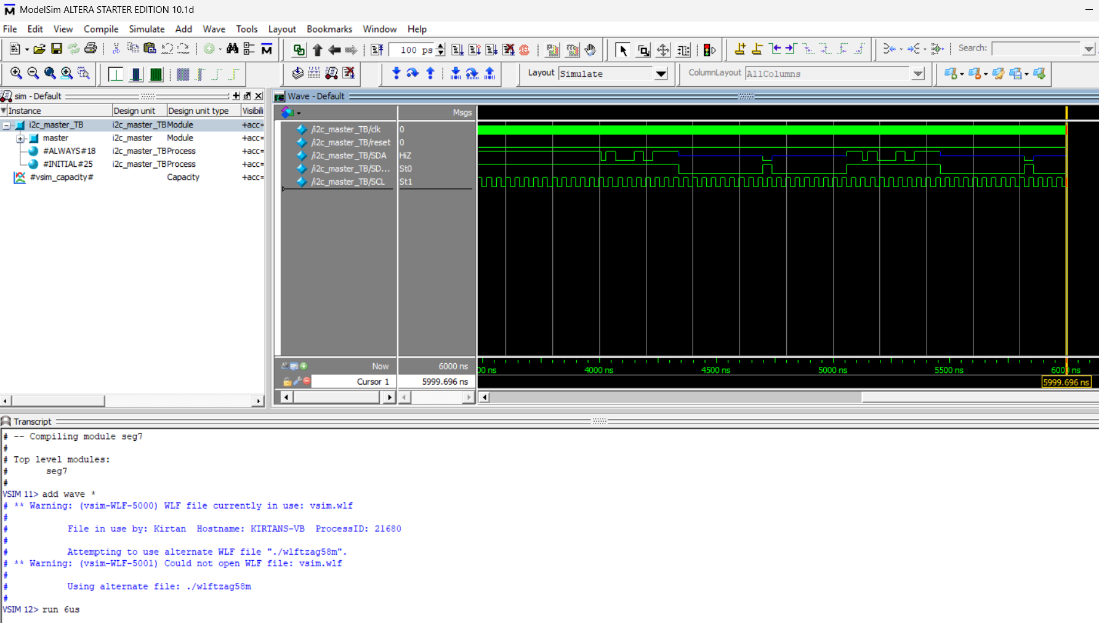
I2c communication

Slide 20
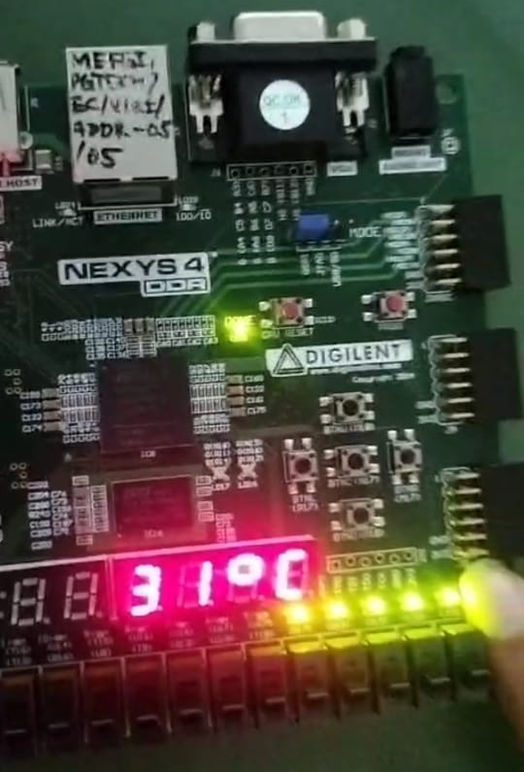
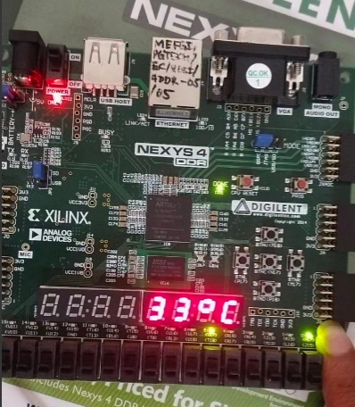
I2c communication

Slide 21
Thank you

